Slide 1
PowerShell From The Trenches - Workflows ...Of Course Yes!
Fast track hands on Powershell Worflows
Jorge Besada, DBA, Carnival Cruise Line

Slide 2


Slide 3
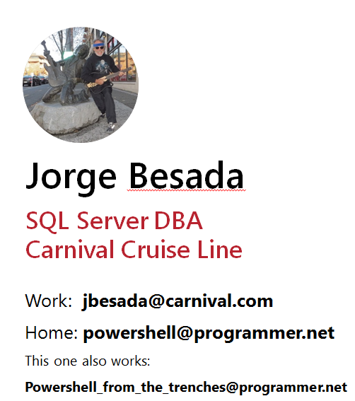
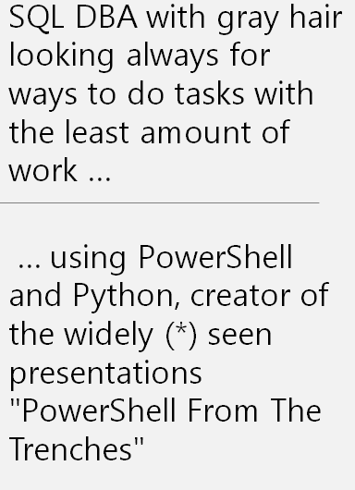

Slide 4
This is the plan
1) WorkFlow – what are they? – the book definition
2) The Hello World workflow program
3) A sample program using jobs
4) A sample program using workflows
5) Jobs program – the workflow version
Goodie

Slide 5
WorkFlow – what is it – book definition
Windows PowerShell workflows are designed for scenarios
where these attributes are required:
* Long-running activities.
* Repeatable activities.
* Frequently executed activities.
* Running activities in parallel across one or more machines.
* Interruptible activities that can be stopped and re-started, which includes surviving a reboot of the system against which the workflow is executing.

Slide 6
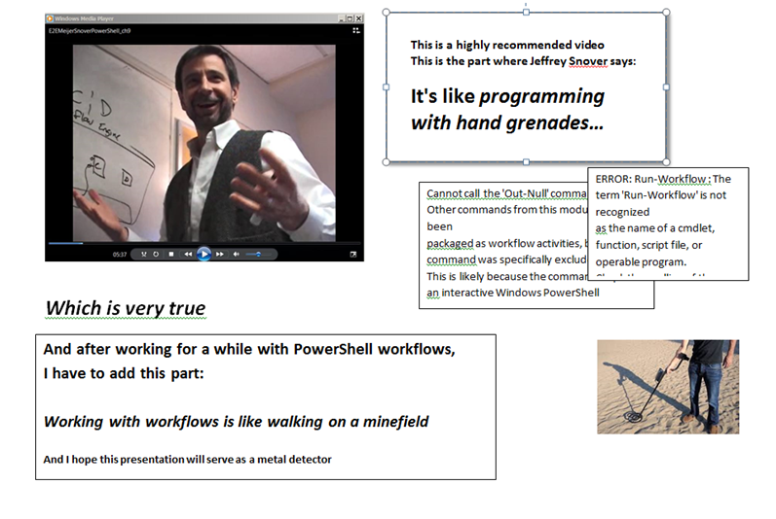

Slide 7
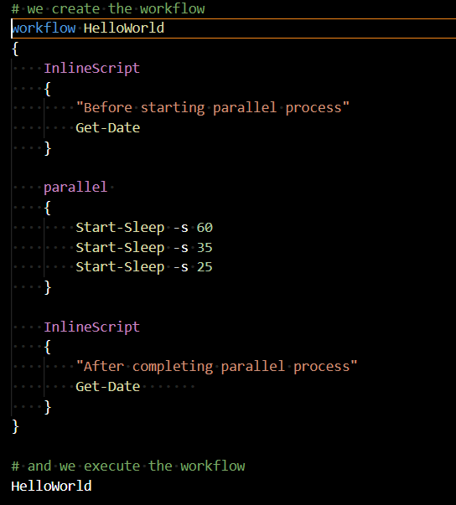
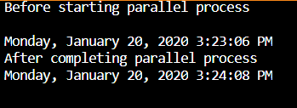
Sample workflow , my HelloWorld version
Take home lessons:
Yes, workflows work as expected:
The total time is the longest of the three “programs”
You define a workflow like a function, and call it
The InlineScripts are your friend

Slide 8
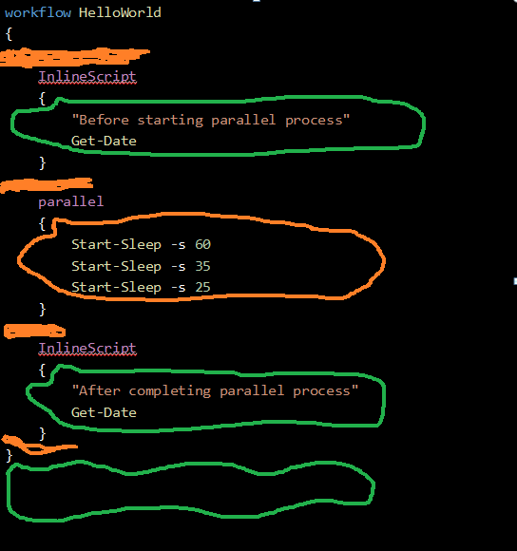
First Things First - Scope and Visibility Green – powershell business as usual area Orange: workflow rules apply
workflow HelloWorld
{
InlineScript
{
"Before starting parallel process"
Get-Date
}
parallel
{
Start-Sleep -s 60
Start-Sleep -s 35
Start-Sleep -s 25
}
InlineScript
{
"After completing parallel process"
Get-Date
}
}

Slide 9
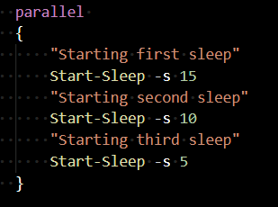


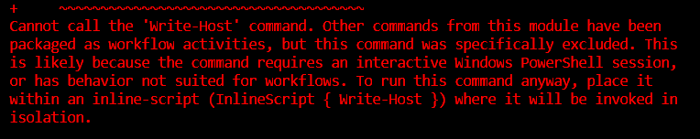

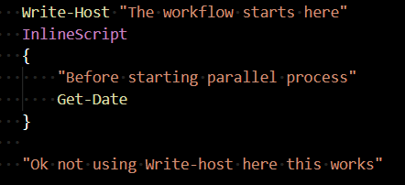
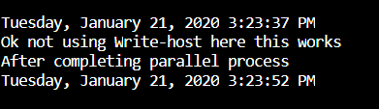
Get used to weird things
This is nice
This is naughty
So this are the suggestions:
In case of errors: use InlineScript when possible
In case of doubt: use InlineScript
When inside Workflow: the error messages are quite detailed ☺, learn from them

